Slide 1



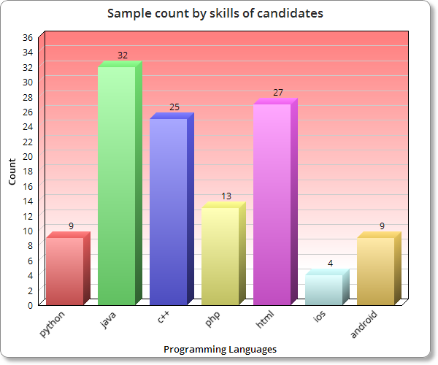
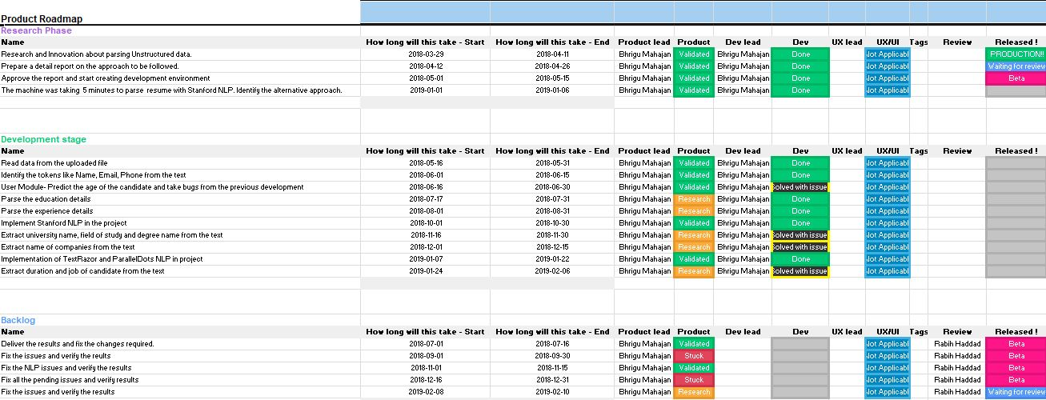
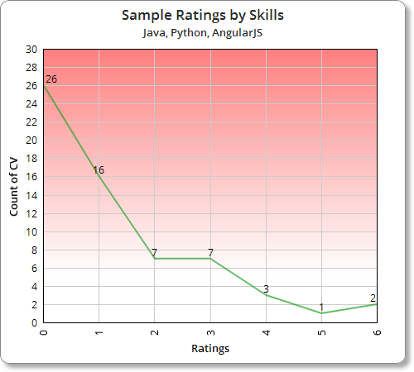
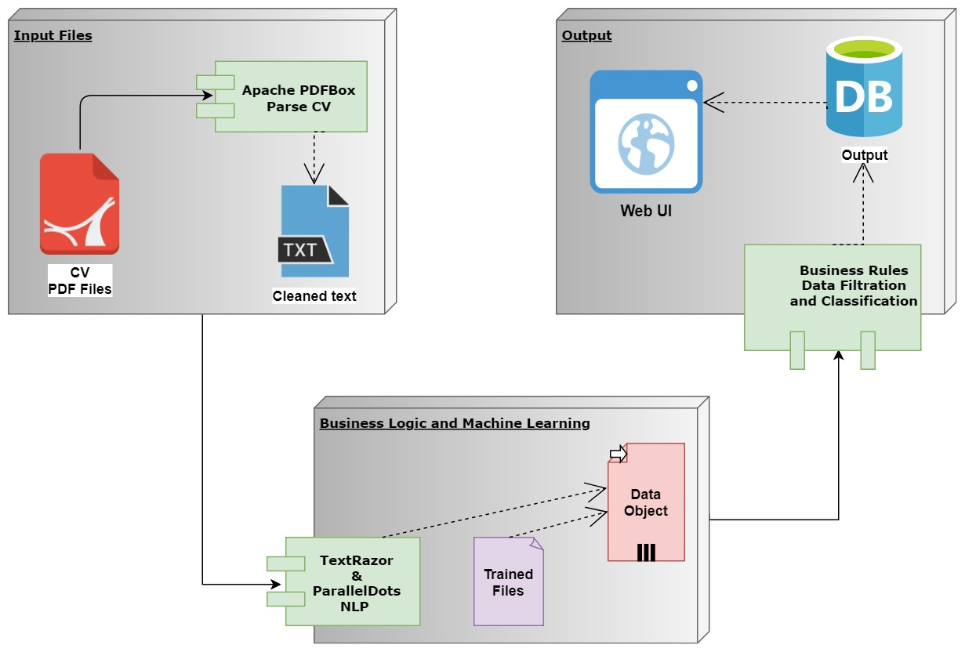
CV TEXT MINING
Team logo
Bhrigu Mahajan
Sample count by skills of candidates
TOOLS AND METHODOLOGY
PROJECT ROADMAP
PROJECT DESCRIPTION
This project is the implementation of retrieving meaningful text from a CV and to apply business rules on retrieved data to evaluate the CV.
The goal of this project is to examine and propose an approach which would consider the skill sets from the potential CV, along with expertise domains like related work experience and education, to score the selected relevant CV.
This approach aims at highlighting the most important and relevant CVs, thus saving an enormous amount of time and effort that is required for manual scanning by the recruiters.
The study presented here is based on the real world data-set of CV. It indicates that the proposed idea has the potential to improve the process used to select CV and highlight the key features of each candidate, and draw attention to the key skills required for a specific job.
Agile methodology is used for the project development because of project flexibility, level of complexity and uncertainty. Every 15 days meetings were planned, respond to changes in requirements by following a plan. Executing the approach and evaluate the results. Documentation and continuous delivery approach is followed.
The www.monday.com/‎ is used as a project management tool for the project. It is a tool that simplifies the way teams work together - Manage workload, track projects, move work forward, communicate with people. Figure 3 and below is the link for my road map in the project.
https://view.monday.com/181684703-9129aa1d8d51dcb145bc52f77aef4ad6
Count of Candidates
Figure 1. Sample Skills Data Extracted from CV.
Figure 3. The Roadmap followed in the project.
RESEARCH CONCLUSIONS
CONCLUSIONS NEXT STEPS
There are lot of APIs in market for data mining but the accuracy of extraction with valid response is still questionable. In this project lot of NLP like Stanford NLP, Open NLP, Weka is used but none of them provide accurate meaningful results for the data. All these NLPs are the product of big universities like Stanford University and University of Waikato and they are continuously doing research make these NLPs more accurate. The companies which are working in the field of CV text parsing are using pattern based algorithms with machine learning and huge datasets which take years and years to build product.
In this project business rules with machine learning is used to extract meaningful relevant data but still required more rules to achieve 100 percent accuracy. This can be achieved in future by preparing a trained data set with our current extracted categorized results.
The results identified from this research is only validates standard format of CV. We can get more filtered results by adding more business rules in project.
The next step in project is to provide rating on the combination of skills, university, experience, job profile and company of the candidate.
DEVELOPMENT
The first approach used in development was the pre trained files used by my analysis to remove useless words from the text.
Algorithm is used to parse meaningful text from the CV on the basis of verbs used.
GooglePhone library is used to find the phone number from the text.
Reg-Ex patterns and keywords based analysis with NLP output used to predict age of the candidate.
Parallel Dots NLP applied with some rules to predict the Name of the candidate.
Text Razor NLP is used to find the skills, languages, education and experience details of candidate.
QUICK FACTS
The project is developed in java 8 with framework of Spring MVC, Spring Security with Maven Build and Postgres 10.4 database.
TextRazor and ParallelDots NLP is used for machine learning.
The processing time for a CV is less than 15 seconds.
Rating to a CV is given only on the skill basis for now.
This Project is developed for Research and Innovation purpose only.
Rating of CV By Skills
IMAGE HERE
Number of CV
IMAGE HERE
Ratings
Figure 2. Graphical Representation of the Project
Figure 4. Sample Chart of CV Rating
M.E (S.D.M)-2017
07 Feb 2019
Notes:
This is a template to be used for your PRI project poster to insure the same look and feel for all posters.
The category titles for the sections of text are fixed. The amount of text for each section could vary based on your project.
The charts and images are provided as placeholders. You do not have to use the sample charts provided and may prefer others.
Three charts and two images are not required, but you should definitely have graphics to illustrate key points and to make your poster attractive.
The final version will be printed either A1 or A0 size.

